Slide 1
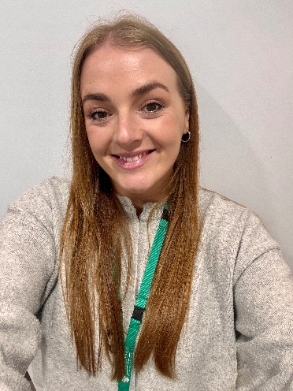



Family Help School and Community Team
Community Drop-Ins
You can find Millie on the following dates and times through the Summer Holidays:
Hedon Children’s Centre - 19 George Street, Hedon HU12 8JH
4th August 2 - 3.30pm
18th August 2 - 3.30pm
Sproatley Village Hall - Sproatley Road, HU11 4GA
10th August 10 – 11.30am
24th August – 10 – 11.30am
Burstwick Mobile Library - Primary School Main Street, Burstwick, HU12 9EA
3rd August 2.05pm - 4.05pm
Paull Mobile Library - Rosegarth Bungalows, Back Road, Paull, HU12 8AE
3rd August 9.20 - 10am
Little Haven Farm - Havenside, Hedon, England, HU12 8HH
29th July 9- 10am
26th August 9-10am
Sport Xplore (Active Communities) - East Riding Leisure South Holderness, Station Road, Hull, England, HU12 8UY
25th August – 1.30 – 2.30pm
Sport Xplore (Active Communities) - Burstwick Village Hall, Main Street, Hull, England, HU12 9ES
18th August 9:30 – 10:30am
Hello, my name is Millie. I am your local Family Help School and Community Practitioner, I will be working in your school and within your community to offer a range of advice and support to families with any worries or questions they may have.
Visit our drop-in session for a range of advice, tips, and resources to support you and your family.
Understanding your child’s feelings and behaviours.
Supporting your child’s emotional health.
Find out about other services that are available to support you.
We are here to offer support early, before worries grow and become harder to manage

