Slide 1

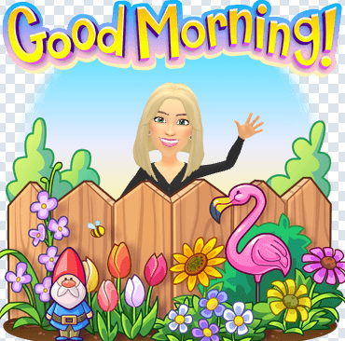
EYFS
Summer 1
Topic: Our Planet
Our new topic this half term is “Our Planet.” This exciting theme will give the children opportunities to explore the world around them, including nature, animals, different environments, and how we can care for our planet. We will delve into texts such as Down in the garden and up in the dirt, Poles apart and Hot and cold.
Reception children will begin phase 4 phonics, focussing on more tricky words and breaking down longer words with their decoding and segementing skills. You can support your child at home by sounding out words such as ‘s-i-ng-i-ng’ in everyday conversations to help them hear the blends and digraphs. Nursery children will continue with their foundations to phonics lessons daily, with the younger children working on their phonological awareness and the older children working on initial sounds ready for their transition to Reception. The children also take part in Maths White Rose sessions daily to develop their understanding of numerical concepts. Reception will continue with building 9 and 10, then move onto 3d shapes and to 20 and beyond. Nursery will look at pattern and shape, space and measure.
We will continue our adventure with ‘drawing club’ at least three times a week. We have noticed great progress in the childrens’s comprehension skills since we began our journey. Each week we focus on a different story, tale or animation and the children are in control of where they want to take their learning to go. We also work on our fine motor skills too afterwards and the staff are in awe of the masterpieces the children are creating.
It is part of EBOR’s universal offer that every child within early years is screened on Wellcomm, which is a toolkit designed for practitioners to identify and support children with their early communication skills. Mrs Seaver will be completing the screening between now and the end of the academic year where she will enjoy one on one time with the children playing communication games.
You can follow your child’s journey on Tapestry, where we share our observations and you can also share activities and progress at home. If you do not yet have access to this, please check your email inbox or let a member of the team know.
We are very excited to announce we will soon be launching our fine motor borrow bags for your child to enjoy different fine motor actvtities at home to support their physical development. More details will follow regarding this shortly,
Thank you for your support,
The EYFS Team
Outdoor learning and PE
Outdoor learning will take place on a Wednesday afternoon. Reception will have PE on Monday with Mrs Seaver and a Thursday with Tigers Trust. Nursery will have PE on a Monday afternoon. Children can arrive in PE kit and will get changed into their uniform afterwards.
Key dates
Thursday 16th April - National Offer day for Nursery children who will be moving into Reception in September 2026 (Please note it will be the local authority that notify you via your chosen method not the school. Please contact school admissions East Riding if you have any queries).
Wednesday 6th May - National Child Measurement Programme (Height and Weight checks Reception and Y6 only) - The LA will have sent correspondence regarding this earlier this year, giving you the option to withdraw if you wish. Any queries please contact them via enquiries@nhsdigital.nhs.uk
Friday 22nd May - school closed for staff training day
Thursday 4th June - trip to Williams Den - more details to follow. All children invited regardless of whether it is their day to attend.
Reading
Reception books will now need to be returned on a Friday.
In preparation for Year 1 all children who have their reading records signed by their parents/ carers, for reading at home at least two times will be given 2 house points each.

