Slide 1

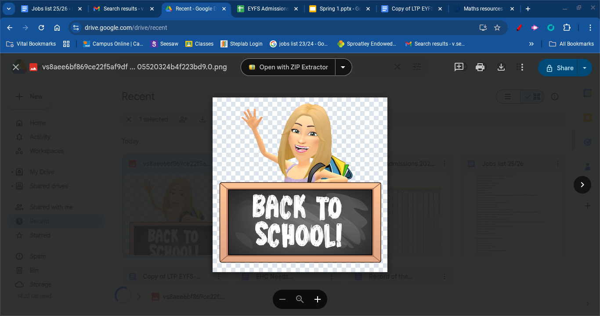
EYFS
Spring 1
Topic: Whose Hat?
Welcome back, we hope you all had a lovely christmas.
A huge welcome to our new starters and their families.
Our new topic is Whose Hat? This topic will allow the children to deepen their understanding of the world, including different environments, countries and faiths. This topic will give the children their prior knowledge to support them before beginning the National Curriculum for Geography and RE in KS1. We will explore this topic through different texts including: Handas Surprise, Hats of Faith and We found a hat!
Our EYFS curriculum is always open ended and child led as we aim to provide the most stimulating opportunities for the children to apply their learning to different contexts. Themes and questioning support the children to explore different areas and lead their learning where their interests take them.
Reception children will begin phase 3 phonics. The majority of children will bring home books with words in January, if your child has a wordless book please encourage them to sound out as many words as possible and continue to practice recognising phase 2 sound. Nursery children will continue with their foundations to phonics lessons daily. The children also take part in Maths White Rose sessions daily to develop their understanding of numerical concepts. Reception will cover Alive in 5, Growing 6,7 and 8 and maths capacity. Nursery will cover counting and shape space and measure.
Parents are invited to a stay and play session to take part in their child’s play on Wednesday 4th February. Please dress for outdoor learning as the majority of the session will be outside. Please arrive at the office at 2.15pm. Please note there has been a change to Nursery PE, due to availability of the hall, their PE will now be Monday afternoons.
You can follow your child’s journey on Tapestry, where we share our observations and you can also share activities and progress at home. If you do not yet have access to this, please check your email inbox or let a member of the team know.
Before and after school, parents are unable to enter the EYFS unit or playground area therefore we kindly ask for you to collect and drop off your child to the member of staff on the gate. A reminder that once your children have been handed over to you at home time, they will have to wait until all children have been collected before entering back into school to retrieve items. The children do have various opportunities and reminders to collect their belongings before the end of the day and although we appreciate forgetting some items, it does make safeguarding and seeing out the remaining children difficult. Waiting until the end allows everyone to remain safe. If you wish to speak to a member of staff please can you also wait until all children have been handed over and a member of staff will happily speak to you. If it is a longer conversation please book an appointment at the office.
The EYFS team would like to say a huge thank you to FOSSA for their donation towards enhancing the outdoor environment. It has allowed the school to develop key areas of provision such as construction, water play and the mud kitchen.
Thank you for your support,
The EYFS Team
Key dates
Outdoor Learning Stay and Play 2.15pm - 3.15pm
PE Kits, Outdoor Learning and Lost Property
Outdoor Learning will take place on a Wednesday afternoon. Reception will have PE on Monday with Mrs Seaver and a Thursday with Tigers Trust. Nursery will have PE on a Monday afternoon with Mrs Murray. Children can arrive in PE kit and will get changed into their uniform afterwards. Please ensure your child has the correct PE kit as per the school uniform policy.
When weather allows, staff will place the lost property boxes at the top of the stairs near the EYFS area. Please check this box first as this is where we keep all unclaimed items. Please ensure all your child's items are labelled.
Reading
Reception books will now need to be returned on a Friday.
We are promoting a love of reading therefore every Friday the children visit the new library and enjoy a story session there. They then get to choose a story to bring home; the children really look forward to this and it is an amazing opportunity for them.

