Slide 1

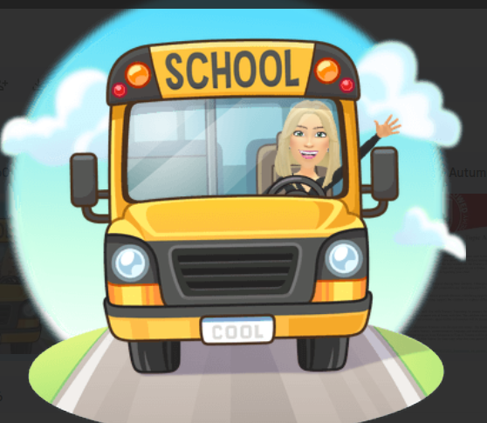
EYFS
Spring 2
Topic: Transport
Welcome back, we are excited for the half term ahead of us.
Our new topic is Transport. Over the coming weeks, the children will be exploring how we get from A to B, from the wheels on the bus to rockets zooming into space. Children will compare transport from the past to the modern day and explore how different vehicles work in our community We will also be touching on some very famous explorers to prepare them for KS1 learning. We’ll be building a rich vocabulary—learning words like engine, and destination—through role-play and storytelling.
Reception children will continue phase 3 phonics, we aim for the children to be able to blend by the end of this term. You can support your child at home by sounding out words such as ‘r-ai-n’ in everyday conversations to help them hear the blends and digraphs. Reading books will continue to be sent home weekly for reception children; please try to read them at least three times over the week Nursery children will continue with their foundations to phonics lessons daily, with the younger children working on their phonological awareness and the older children working on initial sounds The children also take part in Maths White Rose sessions daily to develop their understanding of numerical concepts. Reception will cover measure and building 9 and 10. Nursery will look at shape space and measure, subitising, pattern and counting.
Hopefully, the children have spoken about the introduction of ‘drawing club’ into our learning. At least three times a week, the children are invited into the magical world of tales and story, where they become enriched in language and imagination. Each week we focus on a different story, tale or animation and the children are in control of where they want to take their learning to go. We also work on our fine motor skills too afterwards and the staff are in awe of the masterpieces the children are creating.
It is part of EBOR’s universal offer that every child within early years is screened on Wellcomm, which is a toolkit designed for practitioners to identify and support children with their early communication skills. Mrs Seaver will be completing the screening between now and the end of the academic year where she will enjoy one on one time with the children playing communication games.
You can follow your child’s journey on Tapestry, where we share our observations and you can also share activities and progress at home. If you do not yet have access to this, please check your email inbox or let a member of the team know.
Parent sessions will begin again this half term with a focus this time on our maths curriculum; we received such lovely feedback about the phonics sessions we wanted to extend the opportunity for you to be able to watch a maths lessons too. We are aware that our lessons are right before lunch therefore you will also have the option of staying for lunch with your child afterwards.
Thank you for your support,
The EYFS Team
Key dates
Thursday 5th March - World Book Day
9th March - 13th March - STEM Week theme: curiosity
Friday 13th March 11.30 am - Parents invited to watch a maths lessons and stay with their child for lunch
Monday 16th March 2.15pm - Someone you love stay and play session - as it would have been just mothers day, one family member per family in the unit are invited to a stay and play session focussed around those they love the most. Please note this is not just for the mums - dads, nannas, uncles etc are welcome too! As the unit is only small we can only offer one adult per family to come e.g. if you have a child in nursery and reception it would be one adult only. If your child does not attend a Monday afternoon they are welcome to attend with their adult too.
For all parent sessions please arrive 5 minutes before the session is due to start and a member of the admin team will bring you down.
PE Kits and Forest Schools
Forest School will take place on a Wednesday afternoon. Reception will have PE on Monday with Mrs Seaver and a Thursday with Tigers Trust. Nursery will have PE on a Monday afternoon. Children can arrive in PE kit and will get changed into their uniform afterwards.
Reading
Reception books will now need to be returned on a Friday.
We are promoting a love of reading therefore every Friday the children visit the new library and enjoy a story session there. They then get to choose a story to bring home; the children really look forward to this and it is an amazing opportunity for them.

