Slide 1
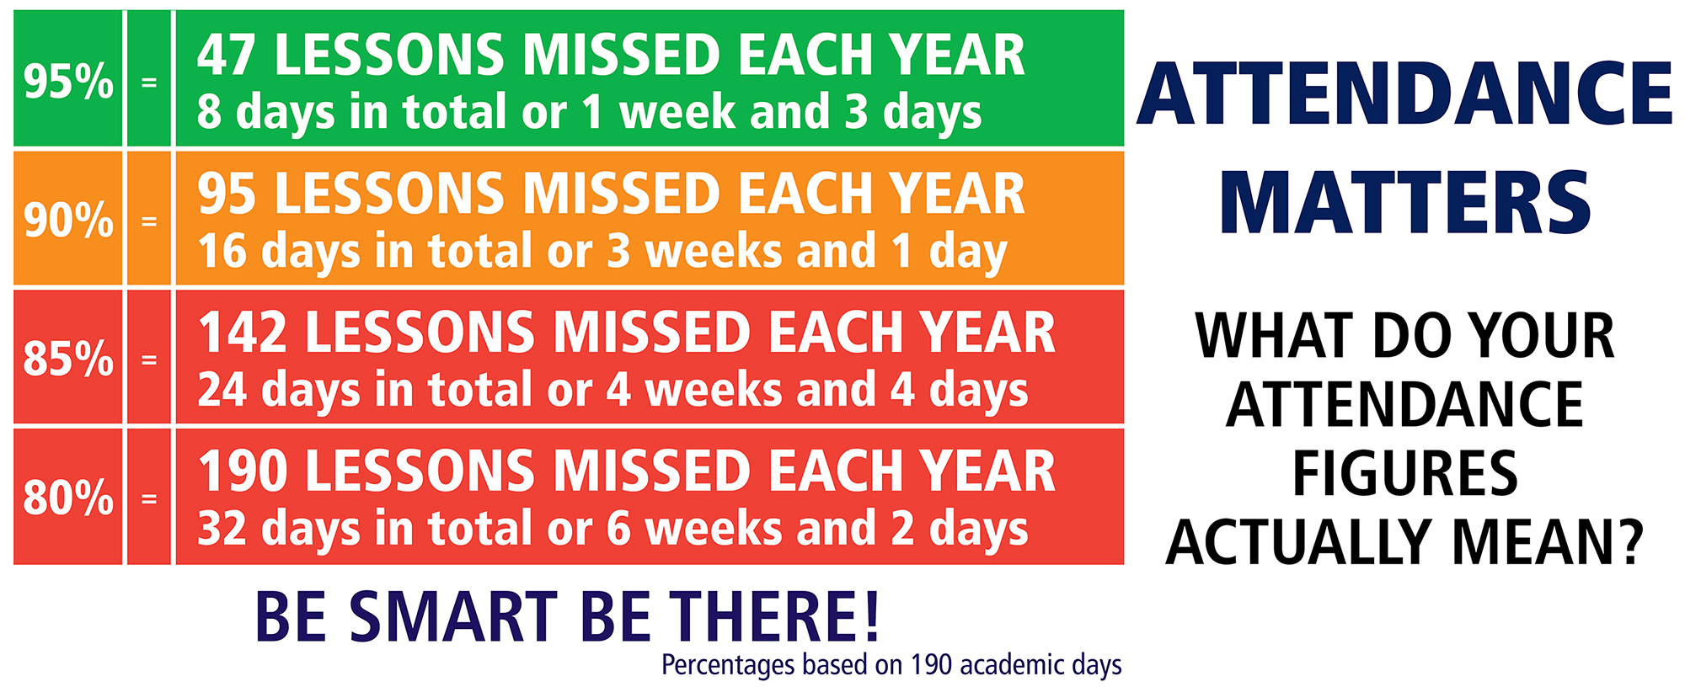
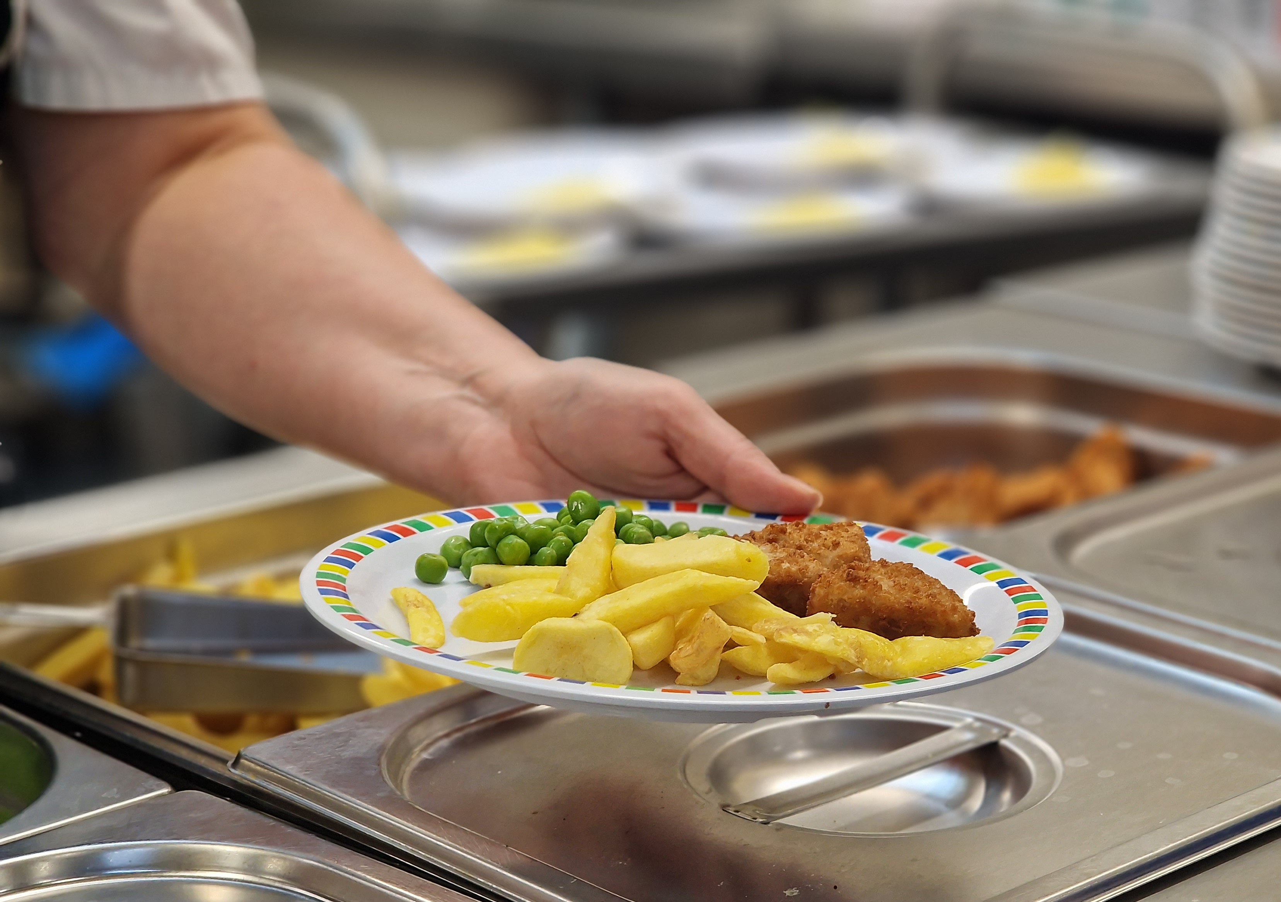
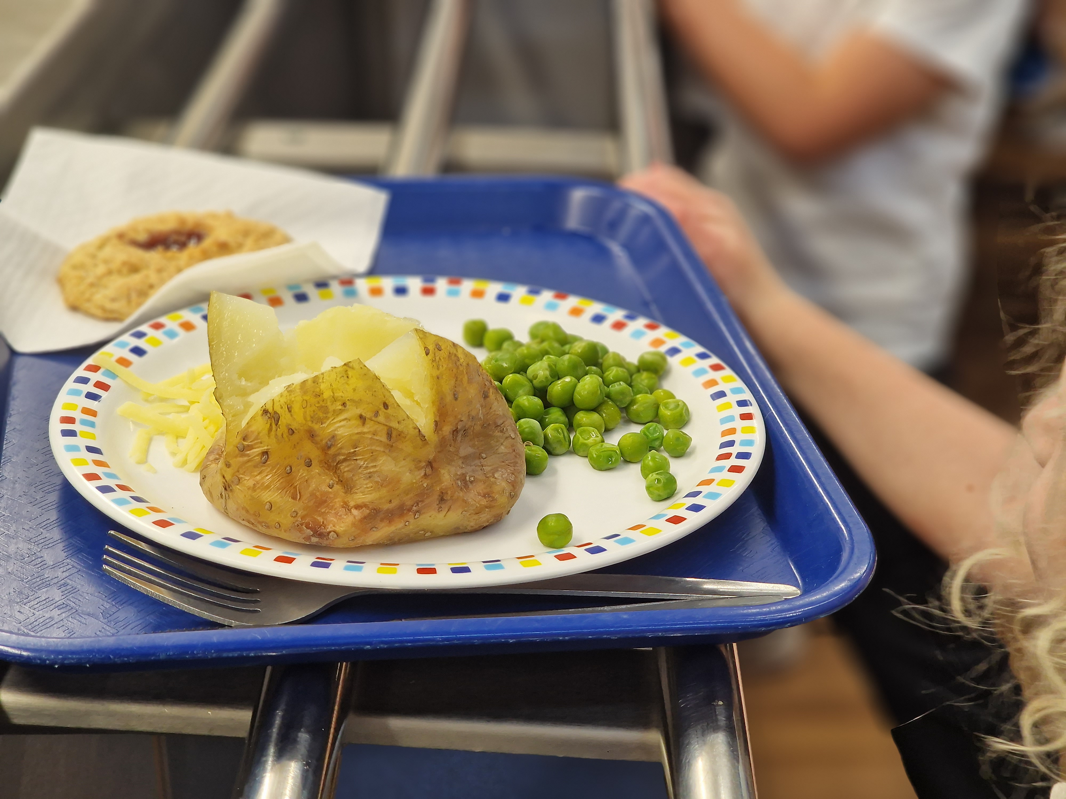
Friday 27th October 2023
WEEK COMMENCING 6th NOVEMBER DIARY DATES
MONDAY Woodwind and piano
Willow / Beech PE
TUESDAY Nursery PE
WEDNESDAY Outdoor learning EYFS
Forest schools pm 1/2
THURSDAY Upper strings music tuition
Guitar tuition
Y3/4 Forest schools pm
EYFS reading afternoon 3pm
FRIDAY Willow / Beech PE
Y3/4 PE
Y5/6 PE
(Please ALL come in PE kits)
Road Safety
A quick reminder to park safely when dropping children off and collecting at the end of the day.
Year 3/4 School Trip
14th December 2023
Museum and Art Gallery
Please see details and payment options on Parentpay
The weather is starting to get colder and our amazing team in the kitchen can provide delicious hot meals at lunch time. Please give our Tree Top Diner a try!
For any ex pupils, living in Flinton, Fitling and Humbleton that are going to University, please remember there is a grant available from the Trustees. Please contact the school office for further details.
Well done to Year 3/4 with 99.04% attendance. Well done.
FOSSA Non Uniform Day
13th November 2023
Please look out for further details

Slide 2
MONDAY
“Yorkshire” all day breakfast with hash browns , baked beans
Chocolate cookie and mandarins
TUESDAY
Pizza pasta, crusty roll, baby carrots, peas
Shortcake and custard
WEDNESDAY
Roast pork, apple sauce, stuffing, mash potato, broccoli, baby carrots, gravy
Chocolate crackle and cream
THURSDAY
Mexican style chicken enchiladas, golden vegetable rice, vegetable sticks
Steamed jam sponge and custard
FRIDAY
Jumbo fish fingers, chips, garden peas, tomato sauce
Oaty fruit crunch and custard
Fresh fruit and yoghurts are always available as an alternative dessert.
Jackets potatoes are available as an alternative every day
Monday, Wednesday, Friday – Cheese and/or beans
Tuesday & Thursday – cheese and/or tuna

